Slide 1
QRCode Reader
IN721 2017
Design and Development for Mobile Devices
Session 12.2
Notes:
Today you are going to build an app that reads QR Codes to perform a specific task.
Make your architecture correctly modular so that it would be easy to modify to make some other use of the codes.

Slide 2
Requirements
The app will:
Provide a main activity with a button to start the reader (i.e. display the camera feed).
Display the camera feed in a second activity which performs the actual QR code reading.
Return the QR code’s text value from the second activity to the main.

Slide 3
Task 1
Read all the codes. Have your app display, for each code read:
The code value
The total times your birth month has been seen, so far.

Slide 4
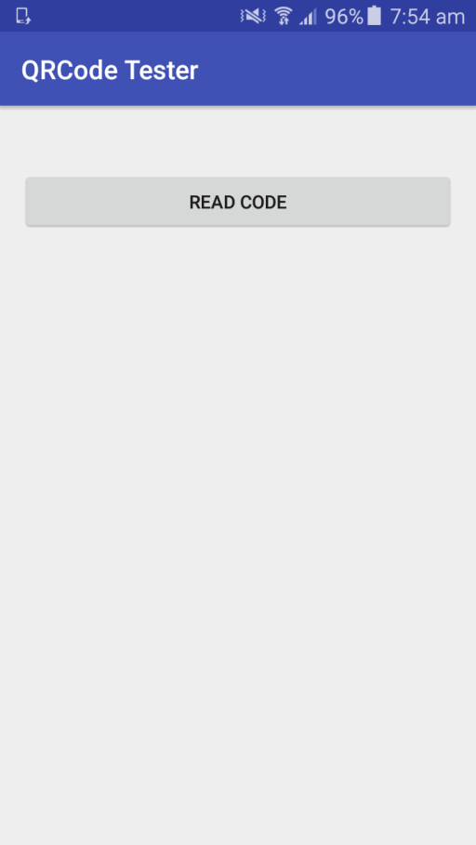
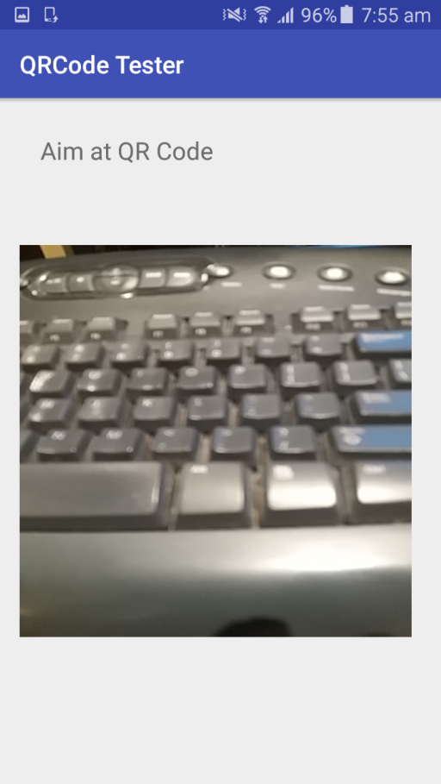
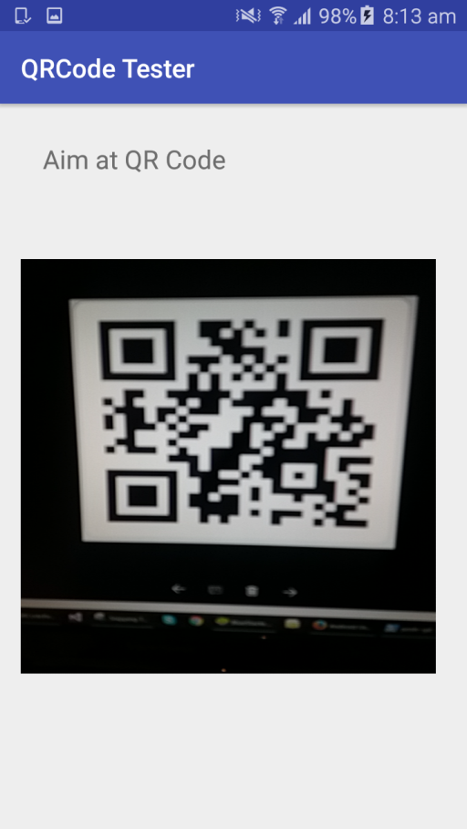
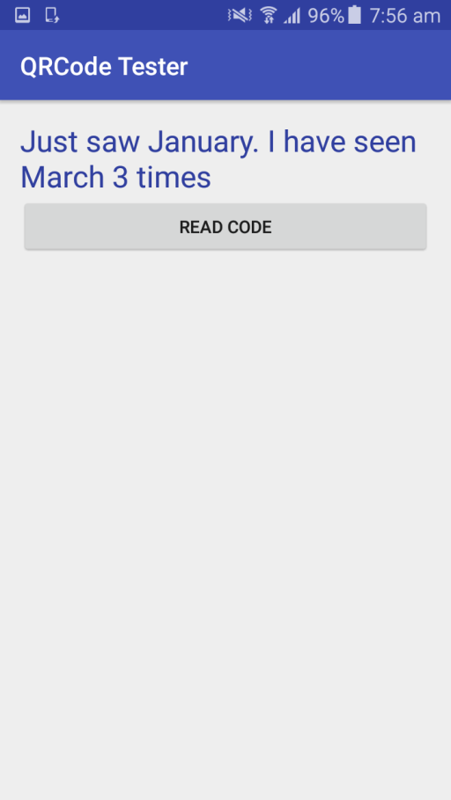
Example
Notes:
Feel free to make your screen design better....
First launch
Button activates the live camera feed (currently looking at the keyboard)
Find a QR Code....
Control is returned to the main activity, and we see the data display.
When you are done, read all the QR Codes up on the wall to figure out how many times your month is represented, and come and show it to me to get the practical marked off.

Slide 5
Task 2
Read all the codes. Have your app display, for each code read, the total count of each month read so far (include 0s).

Slide 6
Task 3
Read all the codes. Have your app detect when a url is found, and navigate to the web page.

